Slide 1

Learning Accord Multi Academy Trust
Safeguarding Briefing
2025

Slide 2

Keeping Children Safe in Education 2025
KCSIE has been updated for 2025.
Staff must read KCSIE 2025 to be sure that you are confident and competent in your role.
“Safeguarding and promoting the welfare of children is everyone’s responsibility. Everyone who comes into contact with children and their families has a role to play…all practitioners should make sure their approach is child-centred. This means that they should consider, at all times, what is in the best interest of the child”.

Slide 3
Summary of changes
Part 1 : Safeguarding information for all staff (no changes made)
Part 2: The management of safeguarding
Para 128: Expect to publish revised guidance on Relationships, Sex, and Health Education this summer.
Para 135: Updated to clarify misinformation, disinformation and conspiracy theories are safeguarding harms.
Para 142: Link added to the plan technology for your school service.
Para 143: Link added to DfE guidance on the use of generative AI in education (2025).
Para 144: Wording amended in the cybersecurity standards for schools and colleges advice to clarify that it was developed to help schools improve their cyber resilience.
Para 169-170: Information added that clarifies and reflects existing AP Guidance.
Para 177: - Updated to clarify ‘working together to safeguard attendance’ ‘is now ‘statutory’ guidance.
Para 199: - Has been amended to clarify that the role of the virtual head has been extended to include responsibility for promoting the educational achievement of children in kinship care.
Para 204: We have added a note to say that we expect to publish the revised guidance on gender questioning children this summer.
Para 205: - Removal of ‘spectrum’ and ‘disorder’ to align with SEND code of practice.

Slide 4
Part 1- Information for All Staff
Safeguarding and promoting the welfare of children is defined as:
Protecting children from maltreatment whether the risk of harm comes from within the child’s family and/or outside (from the wider community), including online;
Preventing the impairment of children’s mental and physical health or development.
Ensuring that children grow up in circumstances consistent with the provision of safe and effective care.
Taking action to enable all children to have the best outcomes.

Slide 5
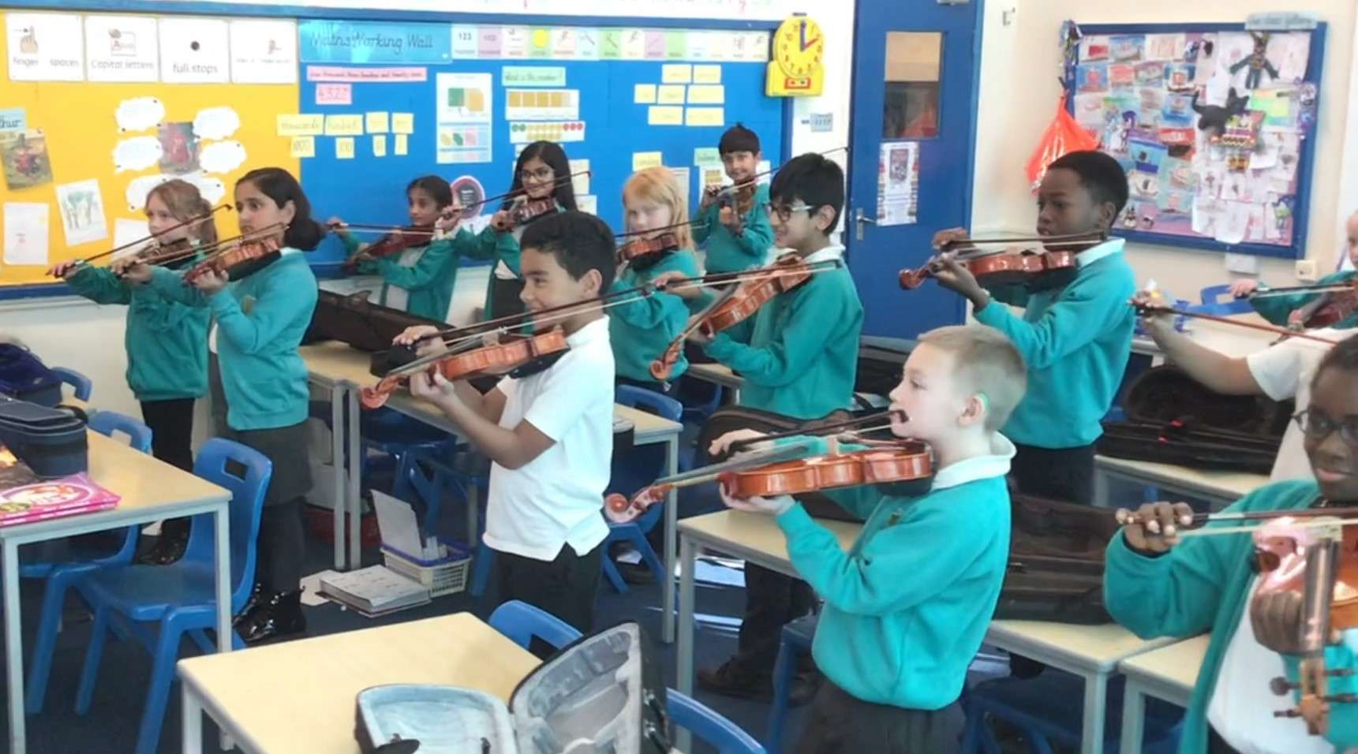
Any staff member who has any concerns should follow the processes set out in paragraphs 49-55 of KCSIE.
The DSL (and any deputies) are most likely to have a complete safeguarding picture/be the most appropriate person to advise.
All staff should be aware of systems which support safeguarding:
  Child protection policy
  Behaviour policy
  Anti bullying policy
  Staff behaviour/code of conduct policy
  Safeguarding response to children missing in education

Slide 6
Reminder: Types of Abuse
Categories of Harm
Emotional
Persistent emotional maltreatment of a child, which can negatively impact their self-esteem, emotional development, and mental health. It may involve constant criticism, threats, or manipulation.
Physical
This involves any intentional physical harm to a child, such as hitting, shaking, burning, or poisoning. It also includes failing to protect a child from such harm.
Neglect
Failure to meet a child's basic needs, including physical, emotional, and educational needs. Neglect can involve inadequate food, clothing, shelter, or healthcare, as well as a lack of supervision or emotional support.
Sexual
This encompasses any sexual act or exploitation of a child, including sexual contact, exposure, or coercion.

Slide 7
AWARENESS – What do you know about the children in your class?
The Professional Network
School Nurse
Health Visitor
GP
School
Speech and Language
Children’s Centres
Family Support Workers
Young Carers
Youth Outreach
Counselling Services
Adult Services
In any class it is likely there will be children with additional safeguarding needs:
MASH- Multi Agency Safeguarding Hub
Child in Need
Child Protection Plan
TAF- Team Around the Family
Community Hub
EHA- Early Help Assessment
LAC- Looked After Child

Slide 8
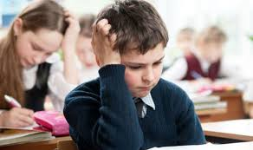
What would you do?
Scenario A:
Saleem, Aged 5
Saleem will only play with other boys and not girls. He is dismissive of female staff and only follows instructions given by male members of staff.
He is part of a family that pays careful and strict observance to their cultural traditions and religious customs.
He recently screamed at and hit a little girl who tried to play with him outside in the school garden. The little girl was very upset and was left with a red mark on her arm.
He denied hitting her and said he told her to go away because she is a girl.
Scenario B:
Beth, Aged 8
Beth is known for being an inquisitive and chatty member of the class. Recently, however, you have noticed a complete change in her behaviour. For the last couple of weeks, Beth has been much quieter and withdrawn. You also notice that although it is a very hot summer and Beth wore dresses a few weeks ago, she has recently been consistently wearing clothes that cover her whole body.
Take a few minutes to discuss this as a group
You may want to watch this short video about the signs and indicators of abuse.
https://www.youtube.com/watch?v=4EY_IrTUhYQ

Slide 9
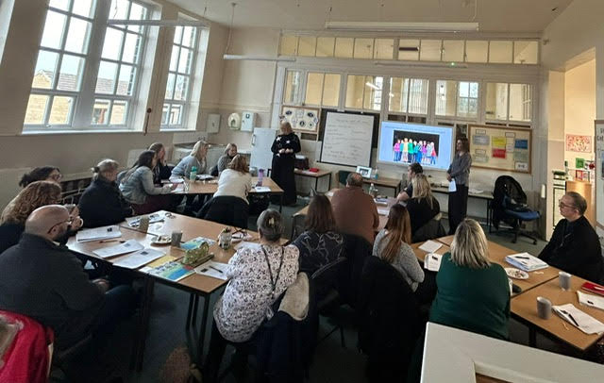
Safeguarding is everyone’s responsibility!
All staff must read part 1 of the KCSIE 2025 guidance and sign to say they have done this!
All staff must read the current MAT Safeguarding policy. NB The policy will be updated during the Autumn term.
Consider the best interest of the child.
Report concerns straight away.
Speak to the Designated Safeguarding Lead.
Everyone has a role to play in identifying concerns, sharing information and taking prompt action.
Staff Induction - Training for all staff now needs to ensure an understanding of expectations, roles and responsibilities around your setting’s filtering and monitoring system.

Slide 10
Part 2- MANAGEMENT OF SAFEGUARDING
The Governing Body or proprietor has ‘strategic leadership responsibility for their school’s safeguarding arrangements.
They must have regard to this guidance, ensuring policies, procedures and training in their schools are effective and always comply with the law.
Headteachers should ensure that the policies and procedures are understood and followed by all staff.
Governing bodies and proprietors should ensure that all governors and trustees receive appropriate safeguarding and child protection (including online) training at induction.
Governing bodies and proprietors should be aware of their obligations under the Human Rights Act 1998, the Equality Act 2010 and the Public Sector Equality Duty.
Schools must make reasonable adjustments for disabled children and young people to deal with particular disadvantages, (e.g. bullying & child on child abuse). There is additional signposting to specialist SEND services.

Slide 11
Part 3 – Safer Recruitment
Schools and colleges should inform shortlisted candidates that online searches may be done as part of their recruitment process.
The section on the retention of documents relating to the various recruitment checks undertaken has been made clearer.
KCSIE 2025 also makes clear the importance of ongoing vigilance that extends beyond the recruitment process.
Ensure staff feel comfortable to discuss matters they are worried may have safeguarding implications, including things they may have seen or heard online.
Advert
Application
Shortlisting
Employment History
References
Selection
Pre-appointment check
Reminders:
Recruitment must safeguard and promote the welfare of children.
Governing Bodies should have safer recruitment training
Carry out all checks including DBS
Check Employment History and References

Slide 12
Part 4 - Allegations and Safeguarding Concerns
What to do when an allegation is made.
Section 1-allegations that meet the threshold
Section 2-allegations/
concerns that do not meet the threshold- low level concerns
Record low level concerns in writing
What a low-level concern is
Referral to LADO when an allegation meets the threshold
Key Aspects:
Allegations - Learning from all allegations should be incorporated by schools, not just those concluded or substantiated.
Allegations - All staff should be aware of how to handle low level concerns, allegations against staff and whistleblowing.
Apply common sense and judgment
Deal with allegations quickly and fairly
Provide effective protection for the child and support the person subject to an allegation

Slide 13
Part 5-Child on Child Sexual Violence and Sexual Harassment
Reminders of key aspects:
Make clear a zero-tolerance approach to sexual violence/sexual harassment.
Never passed it off as “banter”, “just having a laugh”, “a part of growing up”
Failure to do so can lead to a culture of unacceptable behaviour, an unsafe environment and a culture that normalises abuse, leading to children accepting it as normal and not coming forward to report it
Recognising, acknowledging, and understanding the scale of harassment and abuse. Even if there are no reports it does not mean it is not happening, it may be the case that it is just not being reported
Challenging physical behaviour (potentially criminal in nature) such as grabbing bottoms, breasts and genitalia, pulling down trousers, flicking bras and lifting up skirts. Dismissing or tolerating such behaviours risks normalising them
Misogyny- hatred of, contempt for, or prejudice against women.
Misandry -dislike of, contempt for, or ingrained prejudice against men

Slide 14
What examples of sexual violence and harassment might occur in a primary school?
Sexual violence and harassment can occur between children of any age or sex
It can occur through a group of children sexually assaulting or sexually harassing a single child or group of children
Can occur for both girls and boys, but it is more likely that victims will be girls
Schools must make it clear that sexual violence and sexual harassment is not acceptable
Schools must not tolerate or dismiss it as ‘banter’ - A zero tolerance approach!
Consent- this is about having the freedom and capacity to choose. NB. A child under 13 can never consent to sexual activity of any kind. The age of consent is 16.
Sexual intercourse without consent is rape.
Grabbing
Upskirting
Flicking parts of the body or clothing e.g. pants or bras
Sexual activity without consent
Consensual & non-consensual sharing of nude and semi-nude images and/or videos
Inappropriate language - Sexual comments, remarks and jokes
Online sexual harassment
Sexual violence such as rape, assault by penetration
Intentional sexual touching

Slide 15
KCSIE 2025 covers specific safeguarding issues:
Bullying, including cyber bullying
Child abduction and community safety incidents
Children and the Court System
Child criminal and sexual exploitation
Children missing from education
Children missing from home or care
Children with family members in prison
Domestic Abuse
Drugs
Fabricated or induced illness
Faith-based abuse
Online safety and cybercrime
FGM & forced marriage
Homelessness
Peer-on-peer abuse
Modern Slavery
Honour-based abuse
Private Fostering
County Lines
Mental health
Radicalisation/the Prevent Duty
The Court System
Modern Slavery
Serious violence
Sexual Violence and Sexual Harassment
Which of these issues have been experienced in your school or academy community?
Discuss the most common issues that present in your setting.
Identify any issues that you have not come across in your setting, or that you are not aware of.

Slide 16

Recording Concerns:
Reminders:
Record on CPOMS, as soon as possible and the same day.
Include the date, time, who was there and what happened.
Factual not subjective, no personal interpretation or subjective language
Describe what happened- use actual words where appropriate
Before submitting, review and proofread your entry for accuracy and clarity
Record any actions
Do not forget to record any follow up
Who, what, where, when

Slide 17

Takeaway Points
Safeguarding is everyone’s responsibility!
Always act swiftly and report concerns.
Be aware and keep your own knowledge up to date.
Never take a view that ‘it doesn’t happen in our setting’.
Operate with a ‘it could happen here’ approach
Always “operate with the best interests of the child at heart”.
No ‘one size fits all’
Download KCSIE 2025 and refer to it regularly
Complete additional training.
The trust asks that all staff and governors complete the appropriate National College Annual Certificate in Safeguarding for Primary Schools and Academies or provide an alternate certificate to school leaders.
There are many other National College training modules that are of benefit.

